Slide 1
Organic Food
7th floor’s proposal

Slide 2
Why 7th floor?
The reason why our group choose “Seventh Floor” as a name is because some people believe seven is a lucky number, in society we know about “seven” wonders, not eight nor nine wonders. Moreover, and the most important thing that all of our members are living in the seventh floor. The same places somehow give us the advantages and become one of our strategies to make the coordination and collaboration easier.

Slide 3
Why organic as our topic?
Organic foods’ market have been growing in the global market for the past years and it is taking more and more market shares in the food market. Because food market could be considered the largest market in all markets in the world, we choose to study this particular market and choose it as our project’s theme.

Slide 4
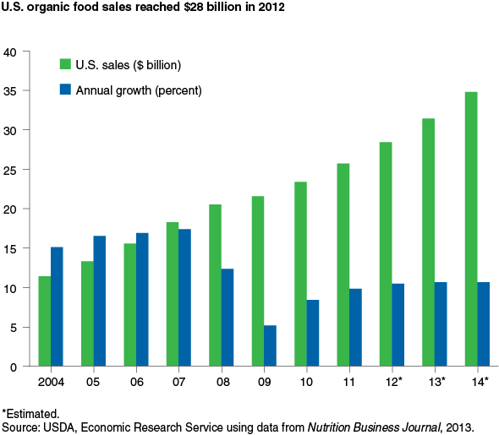
Market growth in America
Have it reached its market saturation?
How about global market?

Slide 5
Project’s outline
- History/development of organic food industry
- Advantages of organic food compared to regular food
- Governments’ policies and regulations in organic food industries
- Technology involved in organic foods’ industries
- Market analysis and market growth of organic food

Slide 6
Logic Model

Slide 7
Participant
Students
Teachers
Classmates

Slide 8
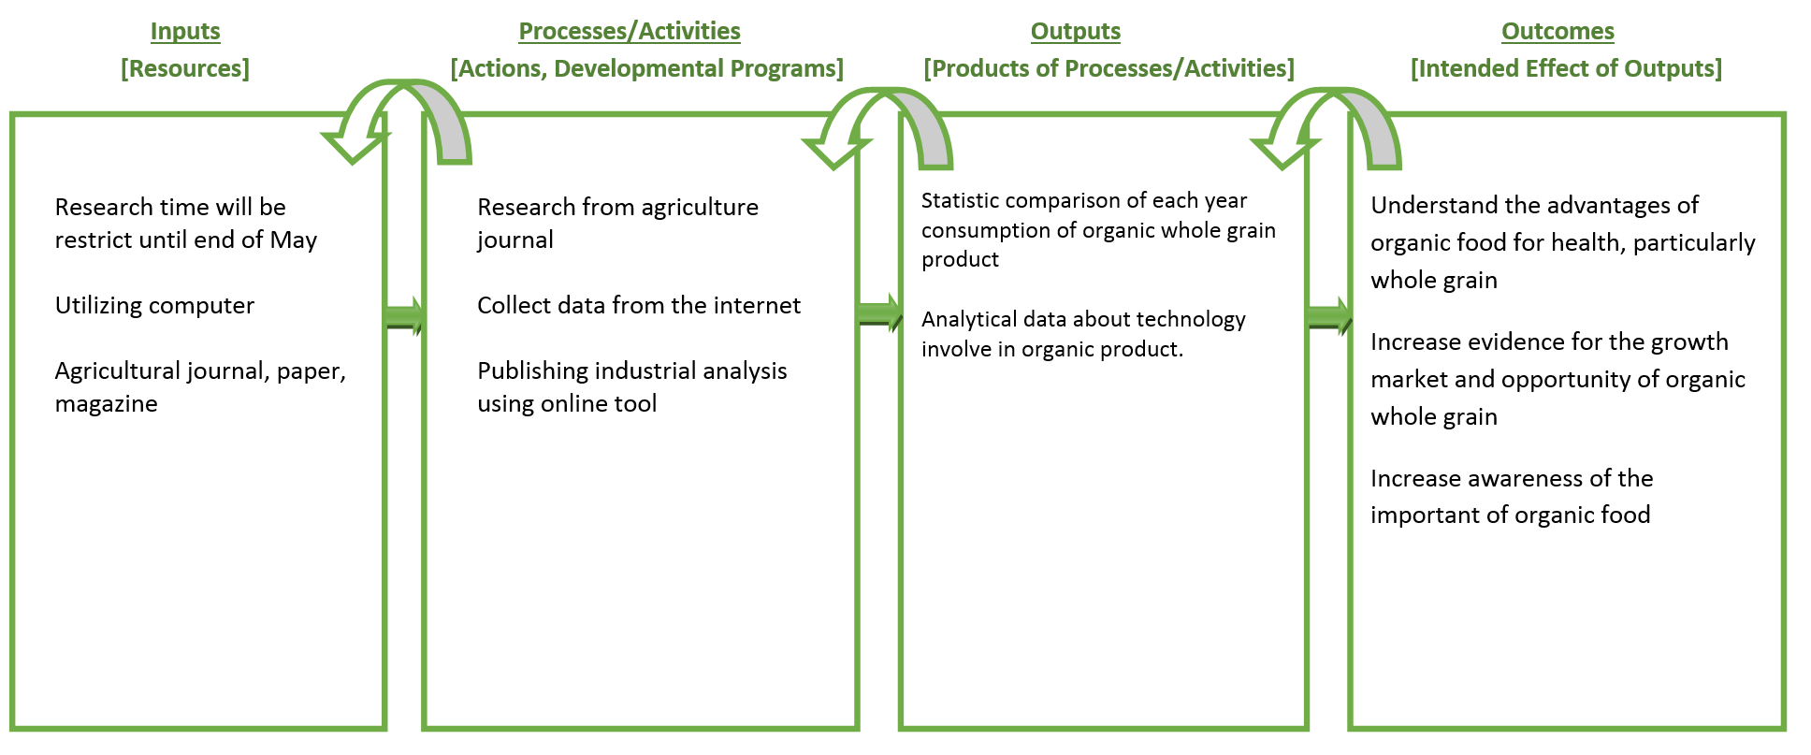
Logic Model

Slide 9
progress
7th Floor

Slide 10

Recall our logic model
Research from agriculture journal
Collect data from the internet
Publishing industrial analysis using online tool

Slide 11
Recall our Project’s outline
History/development of organic food industry
Advantages of organic food compared to regular food
Governments’ policies and regulations in organic food industries
Technology involved in organic foods’ industries
Market analysis and market growth of organic food

Slide 12
“Organic”
7th Floor

Slide 13
History of Organic Product
Year
1920s – 1940s | Writers in the U.S. and Great Britain published influential works introducing the basic idea of organics
1940's | Synthetic pesticides and herbicides were introduced to American agriculture
1940's to 1950's | A loose network of farmers, shunned chemical agriculture by farming organically and writing about their experiences.
1953 | Natural Food Associates (NFA) was formed in Atlanta, Texas, to help connect scattered organic growers with fledgling markets for organically grown foods.
1962 | Rachel Carlson's Silent Spring was published, documenting some of the negative consequences associated with chemical use in agriculture.

Slide 14
History of Organic Product
Year
1970s | Activists across the U.S. to form regional groups and create organic standards by which to certify farmers and their crops. Some point to the United States' ban of the pesticide DDT (dichlorodiphenyltrichloroethane) in this year as the start of the modern environmental movement.
1980s | The National Resources Defense Council (NRDC) released their report on the carcinogenic growth regulator Alar, which was used on apples.
1990s | The organic industry had estimated sales of more than $1 billion and Congress passed the Organic Foods Production Act of 1990, which established the framework to create National Organic Standards.

Slide 15
History of Organic Product
Year
2000 | Organic industry members and consumers, sent over 275,000 comments to the USDA on their proposed National Organic Standards, which included provisions not recommended by the NOSB. The USDA's Economic Research Service released a major study on the status of organics in the U.S.
2001 | USDA passes the Final Organic Rule after reinstating prohibitions on irradiation, sewage sludge and genetically engineered seed.

Slide 16
What is organic ?
Organic is a labeling term that indicates that the food or other agricultural product has been produced through approved methods that integrate cultural, biological, and mechanical practices that foster cycling of resources, promote ecological balance, and conserve biodiversity
(usda, United State Department of Agriculture)

Slide 17
Characteristic Organic food
Avoid chemicals input
Crop rotation
Overall system health is emphasized

Slide 18
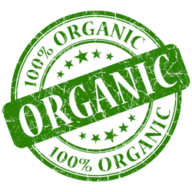
Why Organic Food?
Conventional farming leeches nutrients from the soil, puts a strain on our water supplies, and relies heavily on fossil fuels to make it work;
Organic farming builds better, more self-sufficient land, creates cleaner water, recycles nutrients, and leaves us with a cleaner atmosphere.

Slide 19
Regulation
Based on Electronic Code of Federal Regulations (http://www.ecfr.gov)
(1) Organic Production and Handling Requirements
(2) Labels, Labeling

Slide 20
(1) Organic Production and Handling Requirements
Organic production and handling system plan
Land requirements
How to cultivate the land
How to manage the soil fertility
Notes:
(a) The producer must select and implement tillage and cultivation practices that maintain or improve the physical, chemical, and biological condition of soil and minimize soil erosion.
(b) The producer must manage crop nutrients and soil fertility through rotations, cover crops, and the application of plant and animal materials.
(c) The producer must manage plant and animal materials to maintain or improve soil organic matter content in a manner that does not contribute to contamination of crops, soil, or water by plant nutrients, pathogenic organisms, heavy metals, or residues of prohibited substances. Animal and plant materials include:
(1) Raw animal manure, which must be composted unless it is:
(i) Applied to land used for a crop not intended for human consumption;
(ii) Incorporated into the soil not less than 120 days prior to the harvest of a product whose edible portion has direct contact with the soil surface or soil particles; or
(iii) Incorporated into the soil not less than 90 days prior to the harvest of a product whose edible portion does not have direct contact with the soil surface or soil particles;
(2) Composted plant and animal materials produced though a process that:
(i) Established an initial C:N ratio of between 25:1 and 40:1; and
(ii) Maintained a temperature of between 131 °F and 170 °F for 3 days using an in-vessel or static aerated pile system; or
(iii) Maintained a temperature of between 131 °F and 170 °F for 15 days using a windrow composting system, during which period, the materials must be turned a minimum of five times.
(3) Uncomposted plant materials.
(d) A producer may manage crop nutrients and soil fertility to maintain or improve soil organic matter content in a manner that does not contribute to contamination of crops, soil, or water by plant nutrients, pathogenic organisms, heavy metals, or residues of prohibited substances by applying:
(1) A crop nutrient or soil amendment included on the National List of synthetic substances allowed for use in organic crop production;
(2) A mined substance of low solubility;
(3) A mined substance of high solubility: Provided, That, the substance is used in compliance with the conditions established on the National List of nonsynthetic materials prohibited for crop production;
(4) Ash obtained from the burning of a plant or animal material, except as prohibited in paragraph (e) of this section: Provided, That, the material burned has not been treated or combined with a prohibited substance or the ash is not included on the National List of nonsynthetic substances prohibited for use in organic crop production; and
(5) A plant or animal material that has been chemically altered by a manufacturing process: Provided, That, the material is included on the National List of synthetic substances allowed for use in organic crop production established in §205.601.
(e) The producer must not use:
(1) Any fertilizer or composted plant and animal material that contains a synthetic substance not included on the National List of synthetic substances allowed for use in organic crop production;
(2) Sewage sludge (biosolids) as defined in 40 CFR part 503; and (3) Burning as a means of disposal for crop residues produced on the operation: Except, That, burning may be used to suppress the spread of disease or to stimulate seed germination.

Slide 21
(1) Organic Production and Handling Requirements
Crop rotation standard, benefits:
Maintain or improve soil organic matter content;
Provide for pest management in crops;
Manage deficient or excess plant nutrients; and
Provide erosion control
Notes:
(a) The producer must select and implement tillage and cultivation practices that maintain or improve the physical, chemical, and biological condition of soil and minimize soil erosion.
(b) The producer must manage crop nutrients and soil fertility through rotations, cover crops, and the application of plant and animal materials.
(c) The producer must manage plant and animal materials to maintain or improve soil organic matter content in a manner that does not contribute to contamination of crops, soil, or water by plant nutrients, pathogenic organisms, heavy metals, or residues of prohibited substances. Animal and plant materials include:
(1) Raw animal manure, which must be composted unless it is:
(i) Applied to land used for a crop not intended for human consumption;
(ii) Incorporated into the soil not less than 120 days prior to the harvest of a product whose edible portion has direct contact with the soil surface or soil particles; or
(iii) Incorporated into the soil not less than 90 days prior to the harvest of a product whose edible portion does not have direct contact with the soil surface or soil particles;
(2) Composted plant and animal materials produced though a process that:
(i) Established an initial C:N ratio of between 25:1 and 40:1; and
(ii) Maintained a temperature of between 131 °F and 170 °F for 3 days using an in-vessel or static aerated pile system; or
(iii) Maintained a temperature of between 131 °F and 170 °F for 15 days using a windrow composting system, during which period, the materials must be turned a minimum of five times.
(3) Uncomposted plant materials.
(d) A producer may manage crop nutrients and soil fertility to maintain or improve soil organic matter content in a manner that does not contribute to contamination of crops, soil, or water by plant nutrients, pathogenic organisms, heavy metals, or residues of prohibited substances by applying:
(1) A crop nutrient or soil amendment included on the National List of synthetic substances allowed for use in organic crop production;
(2) A mined substance of low solubility;
(3) A mined substance of high solubility: Provided, That, the substance is used in compliance with the conditions established on the National List of nonsynthetic materials prohibited for crop production;
(4) Ash obtained from the burning of a plant or animal material, except as prohibited in paragraph (e) of this section: Provided, That, the material burned has not been treated or combined with a prohibited substance or the ash is not included on the National List of nonsynthetic substances prohibited for use in organic crop production; and
(5) A plant or animal material that has been chemically altered by a manufacturing process: Provided, That, the material is included on the National List of synthetic substances allowed for use in organic crop production established in §205.601.
(e) The producer must not use:
(1) Any fertilizer or composted plant and animal material that contains a synthetic substance not included on the National List of synthetic substances allowed for use in organic crop production;
(2) Sewage sludge (biosolids) as defined in 40 CFR part 503; and (3) Burning as a means of disposal for crop residues produced on the operation: Except, That, burning may be used to suppress the spread of disease or to stimulate seed germination.

Slide 22
(2) Labels, Labeling
Product composition
How to can get label “organic”

Slide 23
Introduction to Brown rice
7th Floor

Slide 24
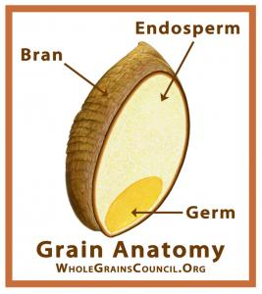
What is Whole Grain?
Any kind of edible plant seeds (aka. Kernel) that contains bran, endosperm and germ
Bran outer layer of a grain; protects the grain from diseases, pests, etc.
Endosperm, food that the germ was fed on
Germ, it is the embryo that will sprout in to new plant.

Slide 25
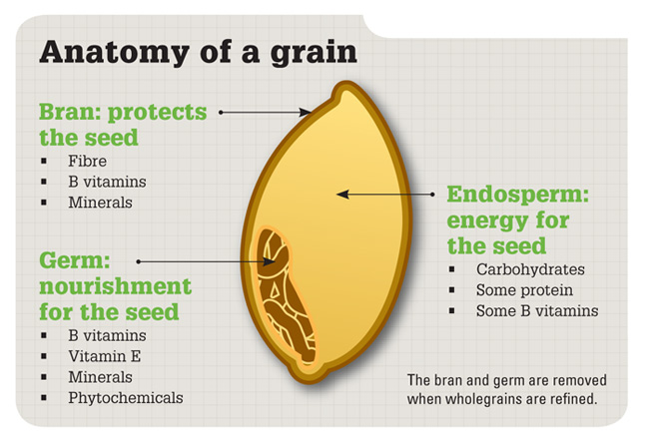
Grain Anatomy

Slide 26
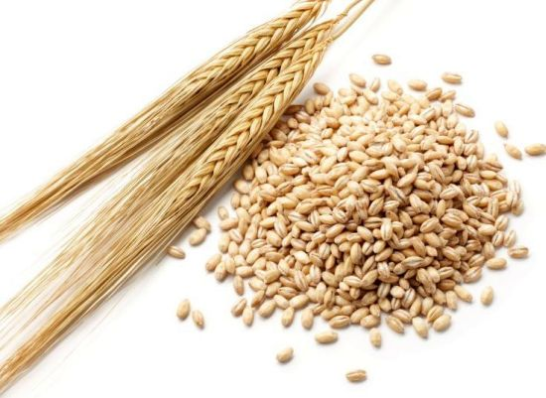
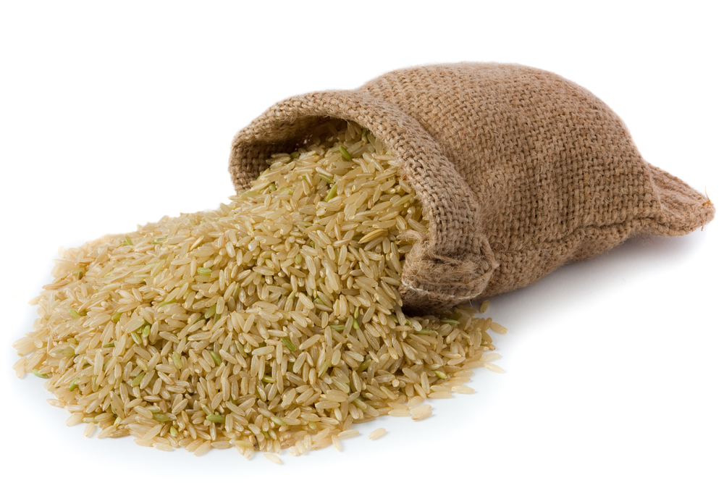
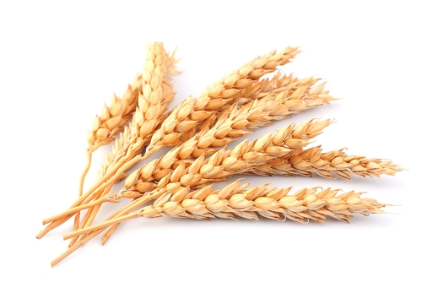
Example of whole grain
Wheat
Barley
Brown Rice

Slide 27
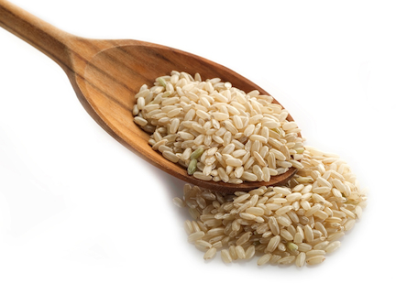
Brown rice contains
Vitamin K : Helps the blood clotting system
Fibre : Helps in digestive system
Thiamine (B1) : Helps boosting immune system
Niacin: Increase HDL and reduce LDL
Magnesium : Lower the risk of Osteoporosis or bone thinning
Iron : Help metabolize proteins/ plays a role in the production of red blood cells
Riboflavin (B2) : Lower risk of muscle cramps, migraine headache, blood disorder and more
Vitamin B6 : Important for brain development and function/ nervous system
Folate : Help forming red and white blood cell in bone marrow/converts carbohydrate in to energy
Potassium : Lower blood pressure; reduce formation of stone kidney; and protect loss of muscle mass
Protein : Building muscle

Slide 28
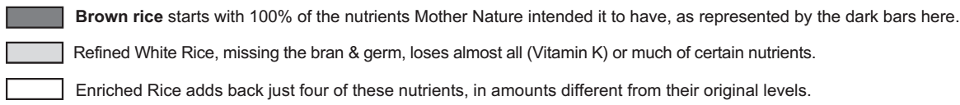
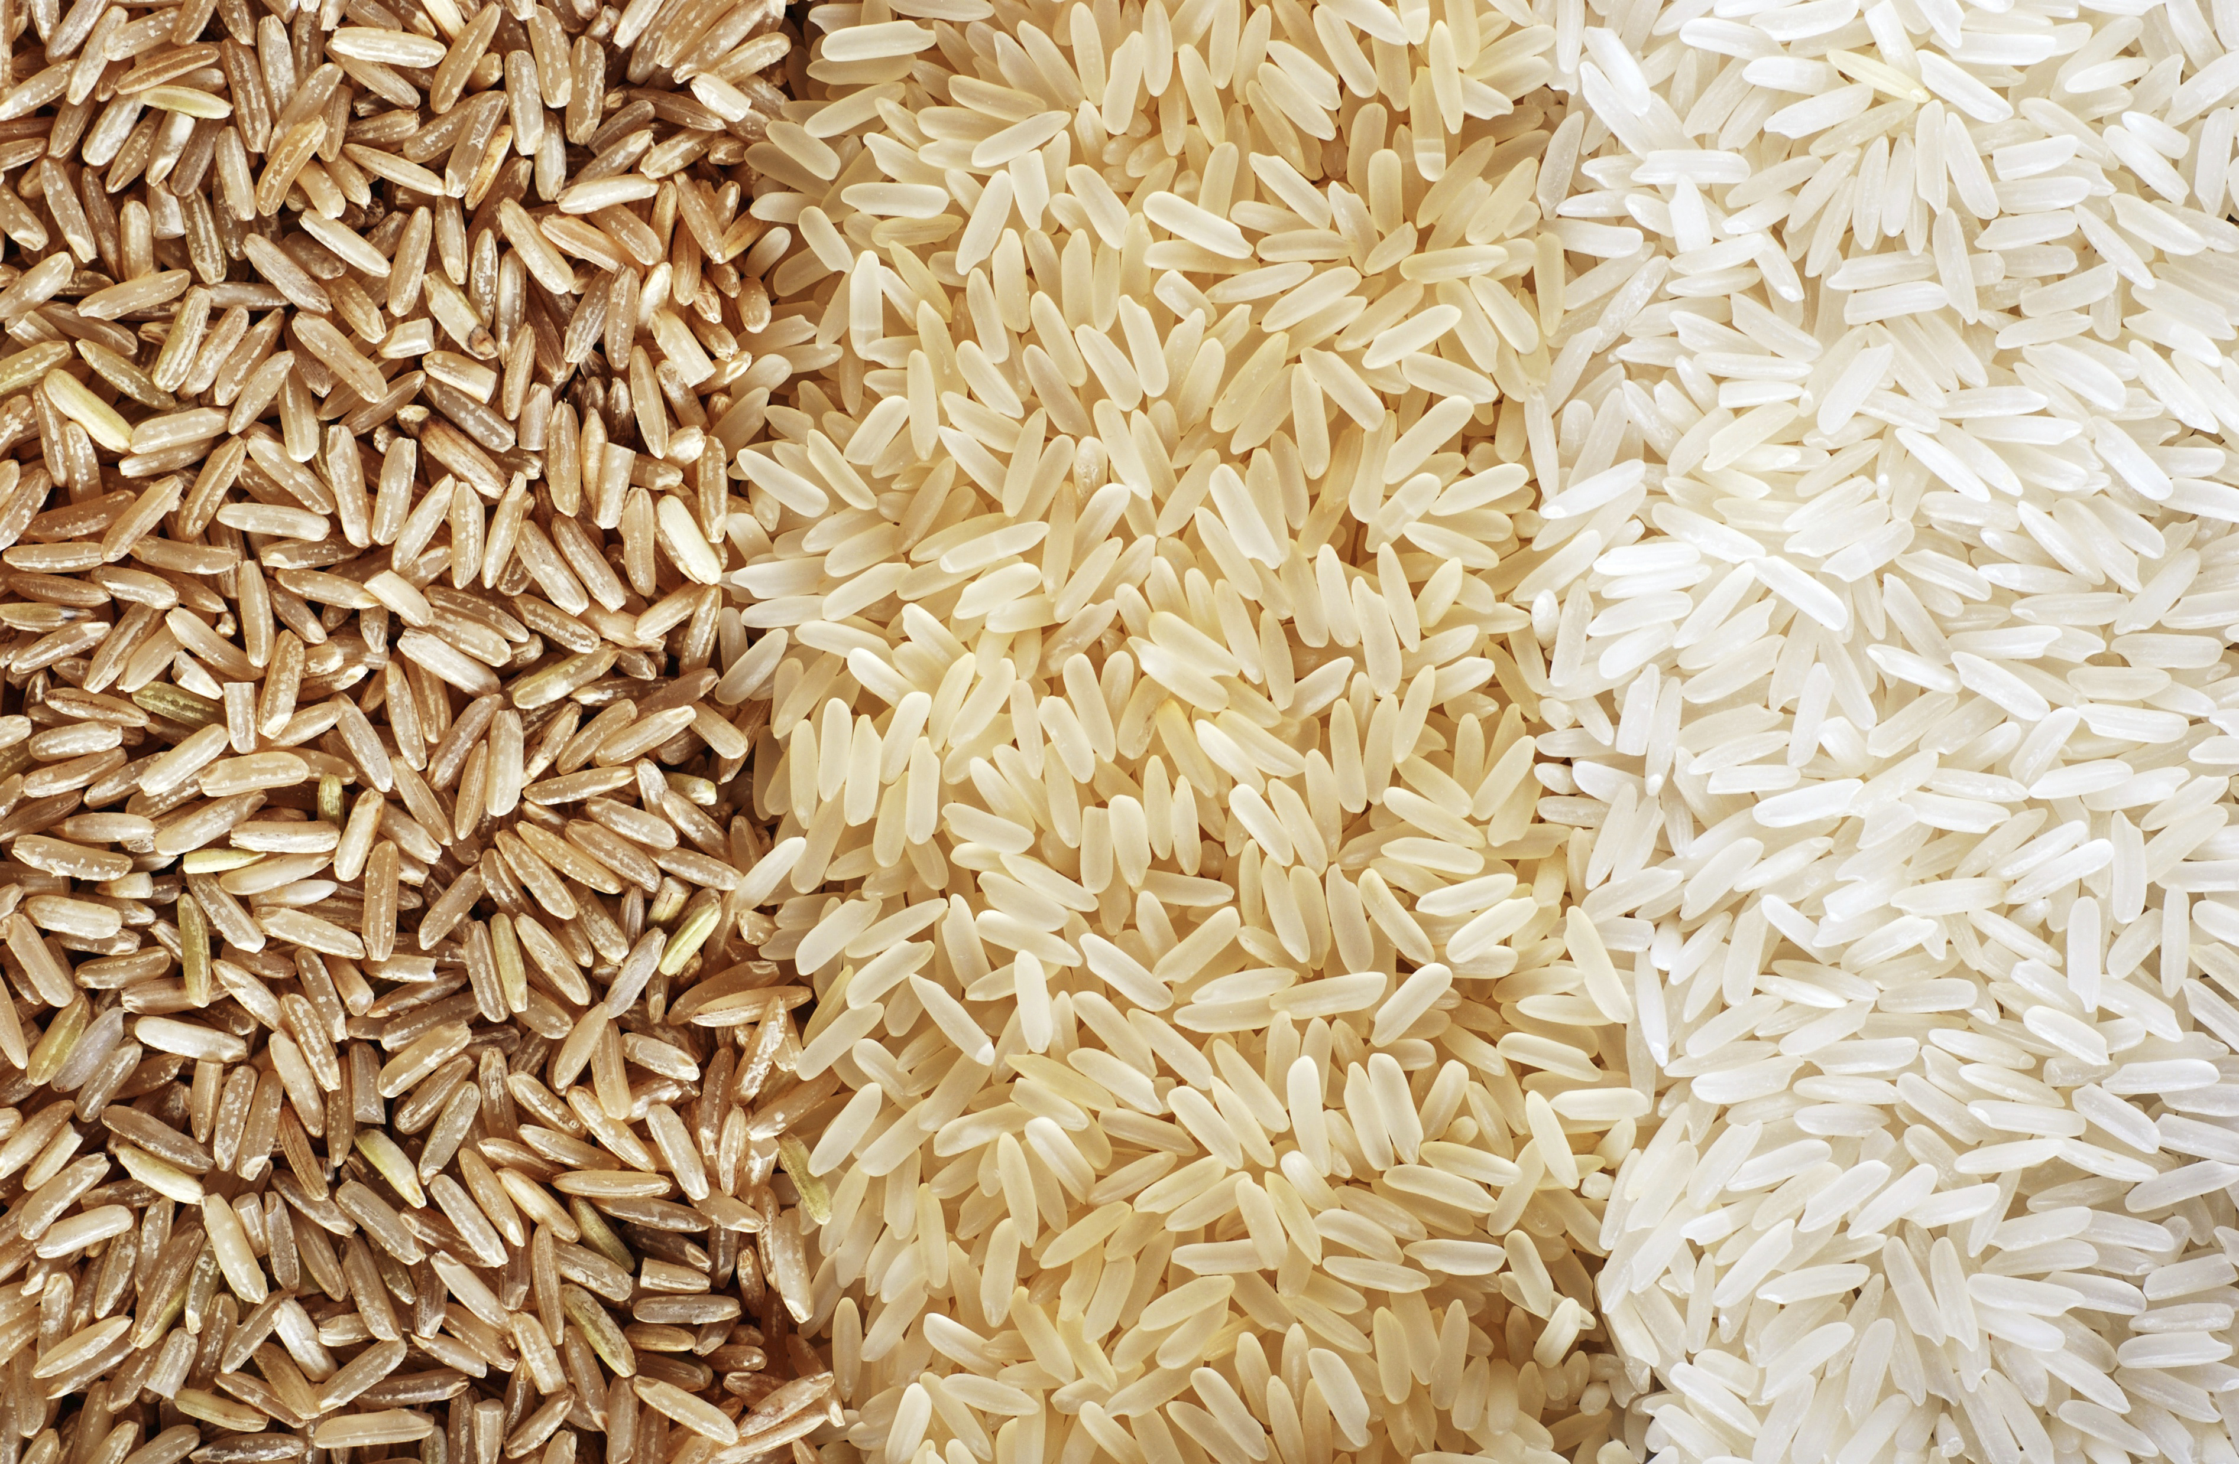
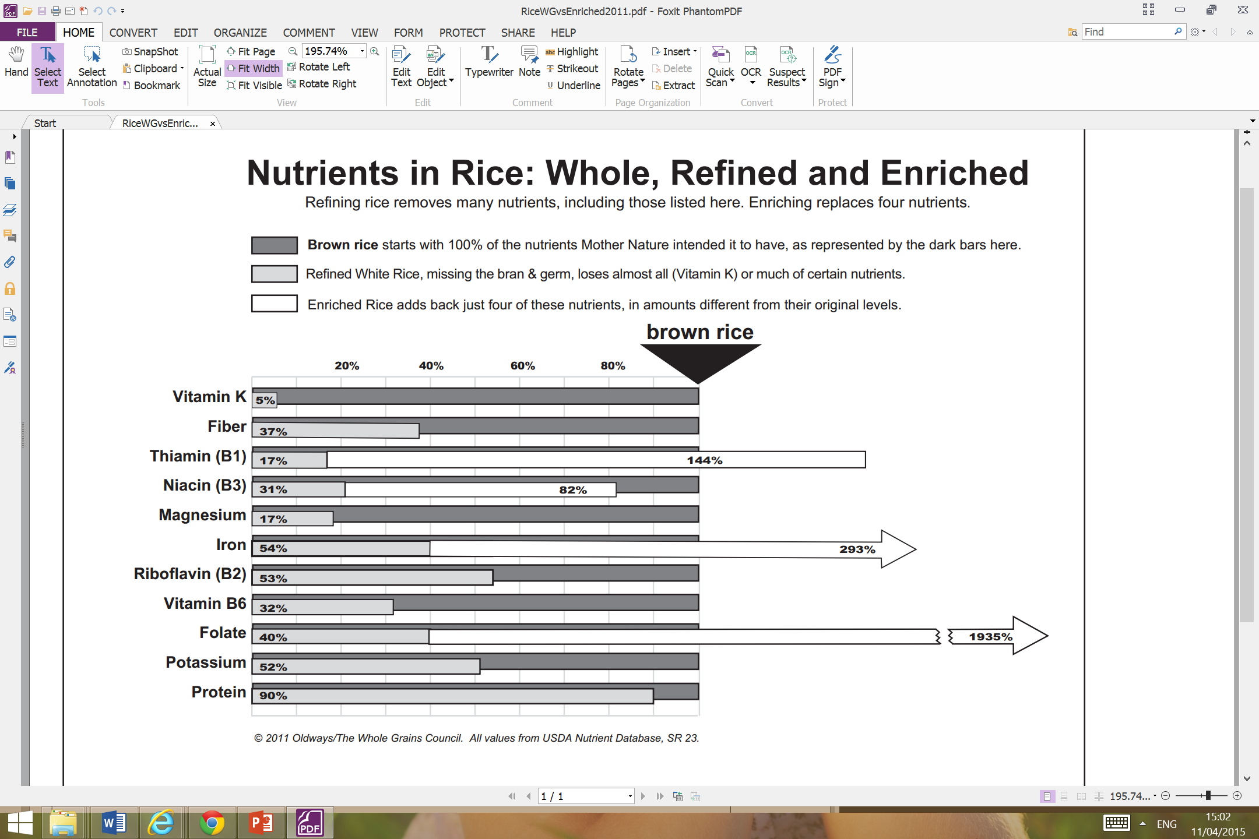
Whole, Refined and Enriched

Slide 29
Rice manufacturing process
7th Floor

Slide 30
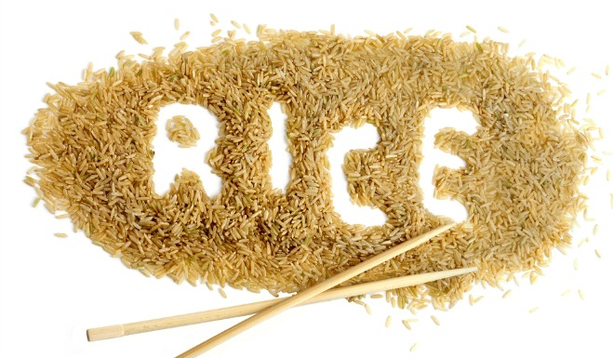
Overall process
Planting
Milling (white rice)
Enriching
Harvesting
Drying
Hulling

Slide 31
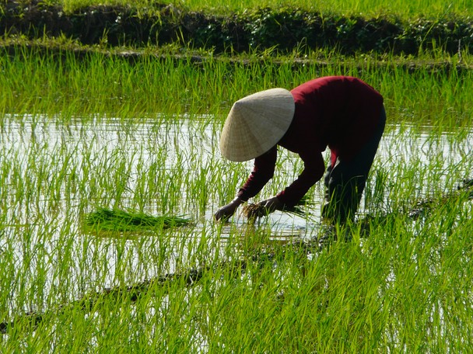
Planting
Soak the seed prior planting
Plant the seed in the flooded paddies (by machine, hand, or plane)

Slide 32
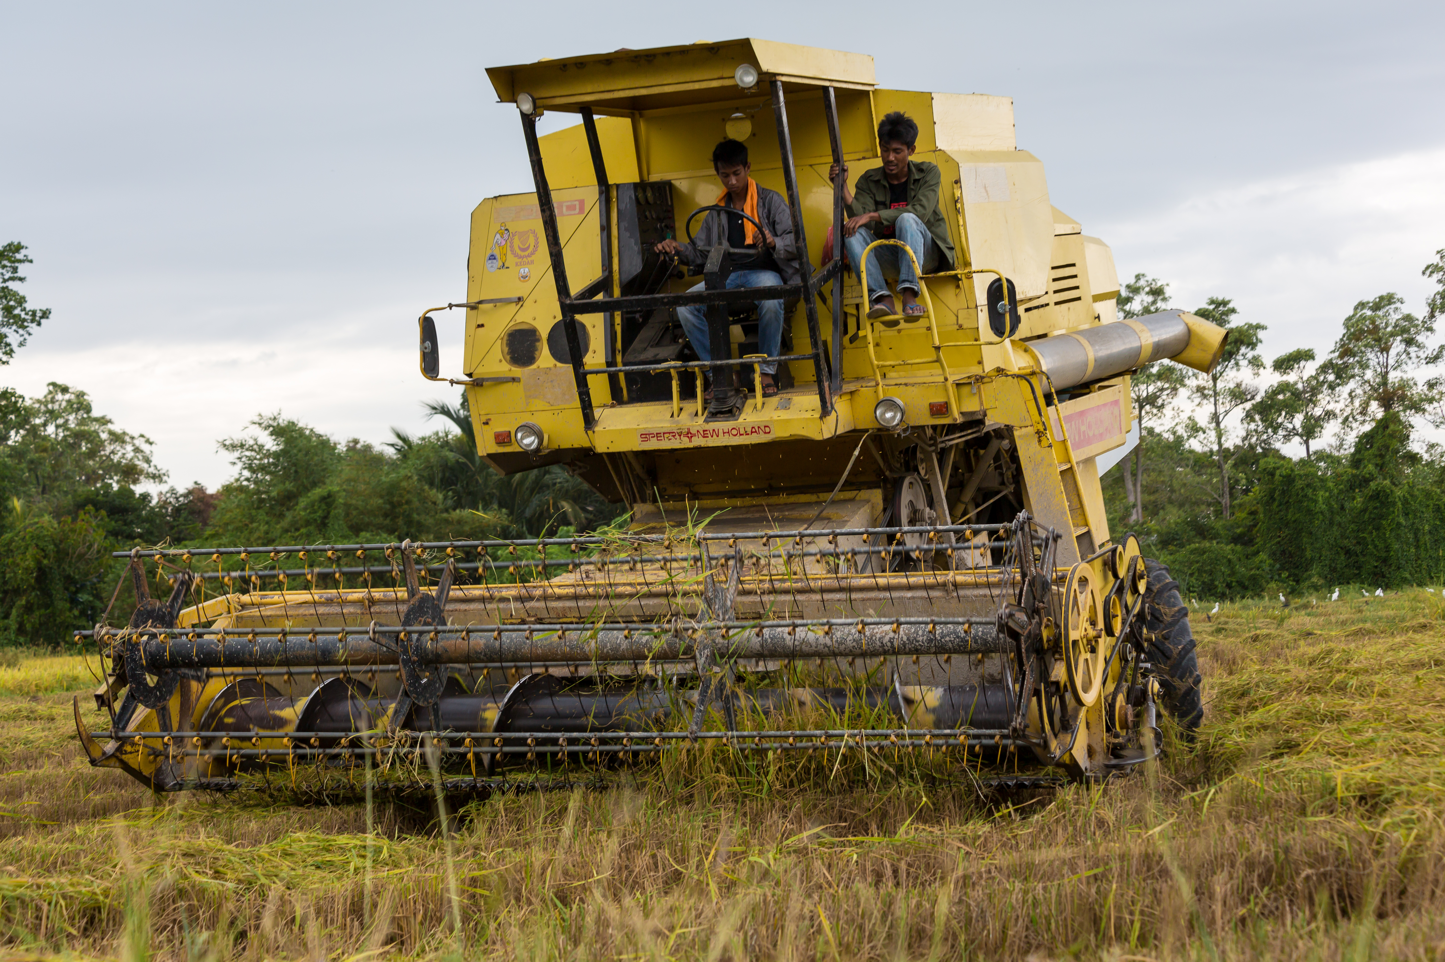
Harvesting
Drain the field dry
Harvest the rice (by hands or tractor)

Slide 33
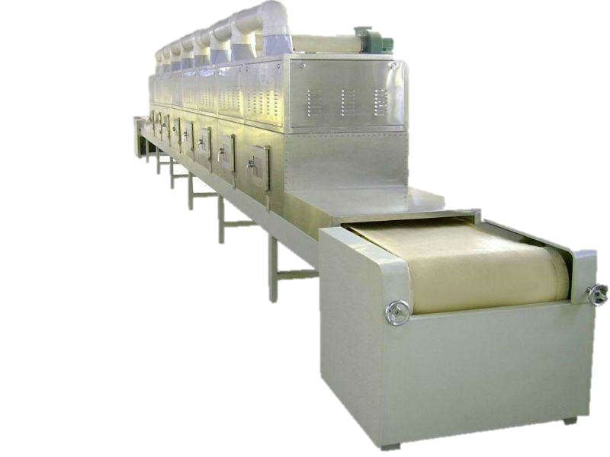
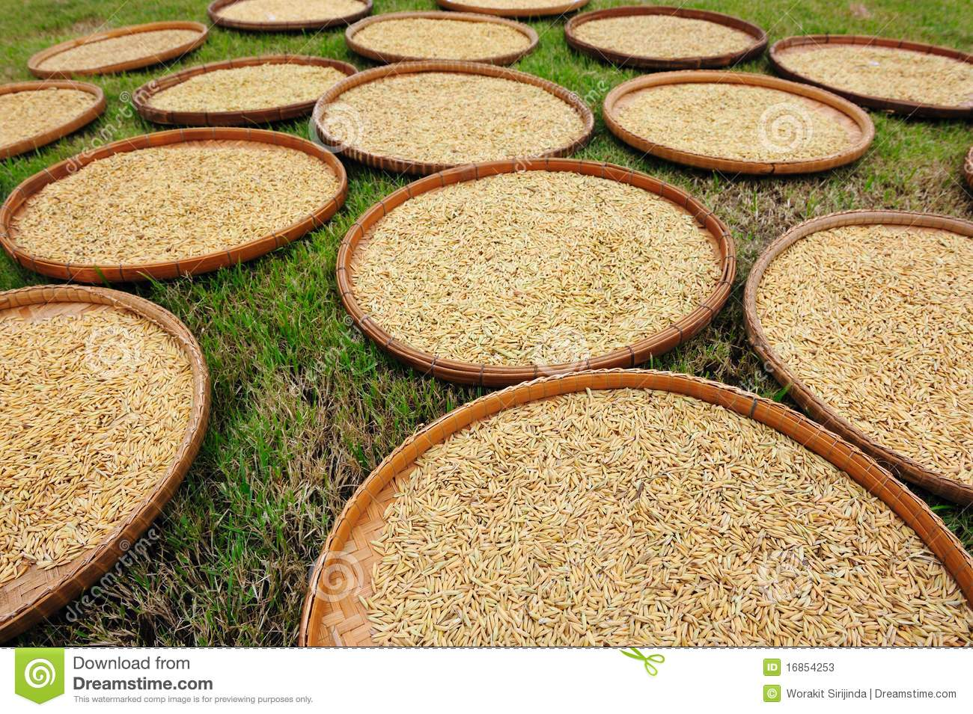
drying
Hot air or sunshine

Slide 34
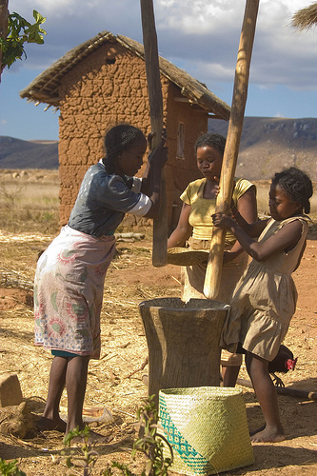
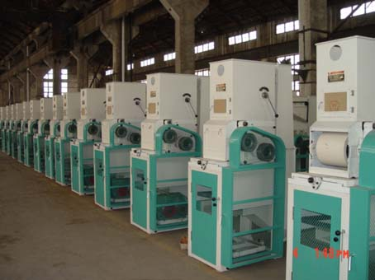
hulling
Grinding or rolling rice with stones
Automated grinding machine

Slide 35
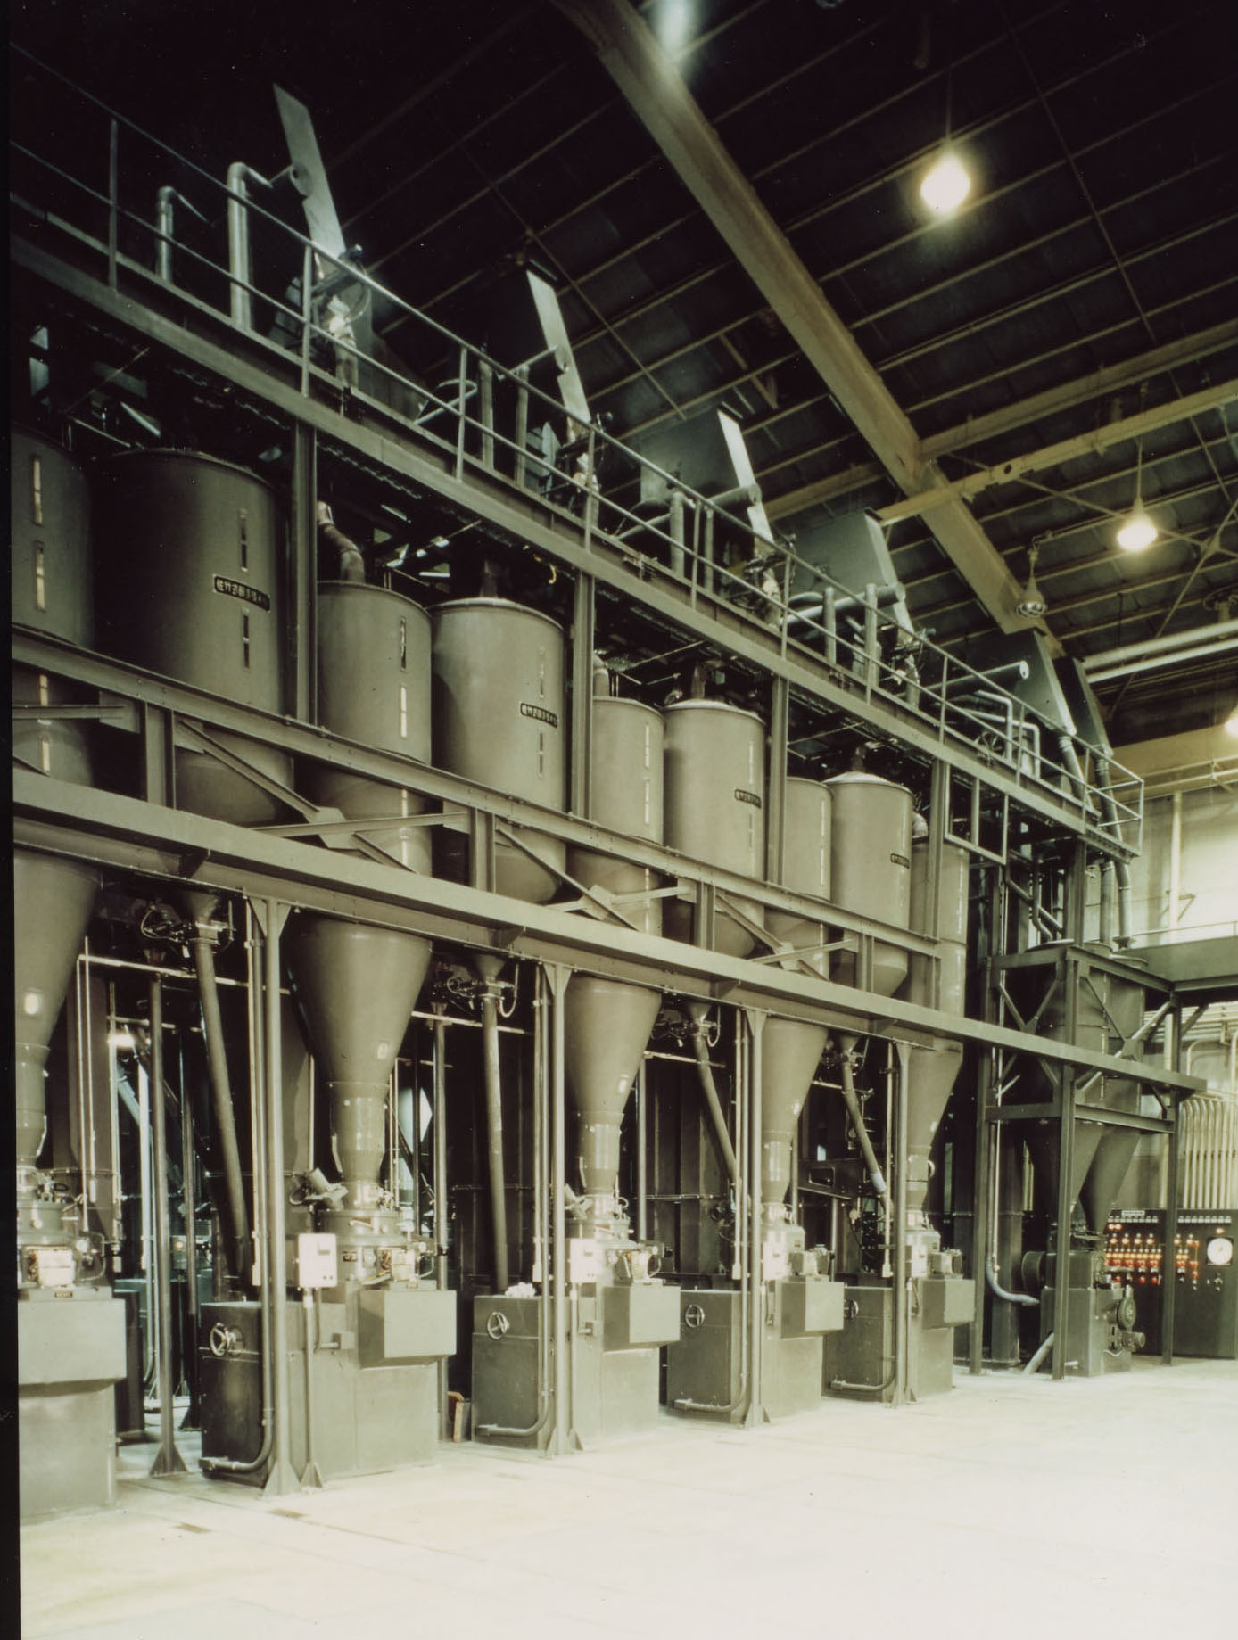
Milling (White rice)
Removing the brand

Slide 36
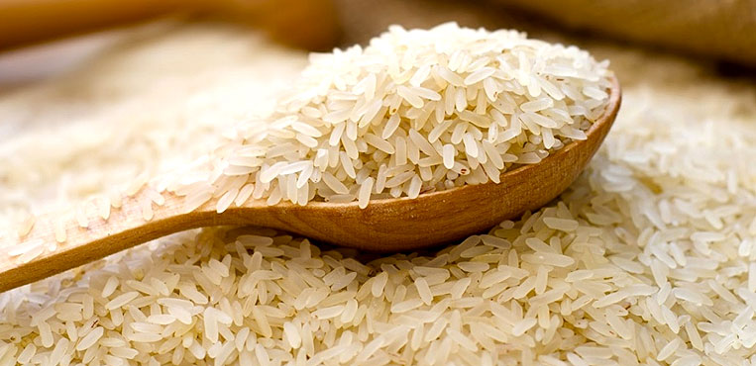
enriching
Steeped under pressure prior the milling
Submerge the rice in vitamin bath

Slide 37
Organic, trustworthiness and transportation
Organic Product Related to Trustworthiness
Organic product can be distinguished from the common products by the label. The label should be acknowledged by government and gain consumers trust
Organic Product Related to Transportation
Organic product has limited time life, therefore transportation issue need to resolve

Slide 38
Progress (2)
7th Floor

Slide 39
OUTLINE
We make some revise to our outline to make the sequence more neat.
Outline :
1. Development of organic food industry
1.1 Definition of Organic Food
1.2 Development of Organic Food
1.3 What define Whole Grain
1.4 What is Brown Rice

Slide 40
OUTLINE
2. Technology involved in rice industries
2.1 Process farming
2.1.1 Planting
2.1.2 Harvesting
2.1.3 Drying
2.1.4 Hulling
2.1.5 Milling
2.1.6 Enriching

Slide 41
OUTLINE
3. Advantages of organic food compared to regular food
3.1 Advantages of Organic Rice
3.1.1 Advantage to the environment
3.1.2 Advantage to the health
3.2 Comparison: Brown rice and White rice
3.2.1 Nutrient Facts
3.2.2 Price

Slide 42
OUTLINE
4. Governments’ policies and regulations in organic food industries
4.1 United States Department of Agriculture (USDA)
4.1.1 Regulation of technology in Farming
4.1.2 Regulation of Using Substances
4.1.3 Regulation of Certification
4.2 Regulation in other places
5. Market analysis and market growth of organic rice
5.1 Market trend
5.2 Market analysis

Slide 43
VARIABLE
Quantitative Variable
Qualitative Variable

Slide 44
VARIABLE
Variable | Quantitative | Qualitative | Note | Sub Category
Price changing | √ |  | Price from year to year always changes | Tolerance
Consumption rate | √ |  | The amount of consumption will change over the time | Tolerance
Production rate | √ |  | The production each year usually increases caused by development of new technology in farming | Technology
Policy revision | √ |  | Period of the policy still valid until being revised by government | Tolerance
Technology improvement |  | √ | The invention of new technology in farming will trigger the production rate | Technology
Consumption habit shifting |  | √ | People lifestyle in eating will change, will influence the consumption rate | Tolerance

Slide 45
VARIABLE
Tolerance
Technology
Price
Technology improve
Production Rate
Technology
Tolerance
Habit
Policy
Tolerance
Consumption rate

Slide 46
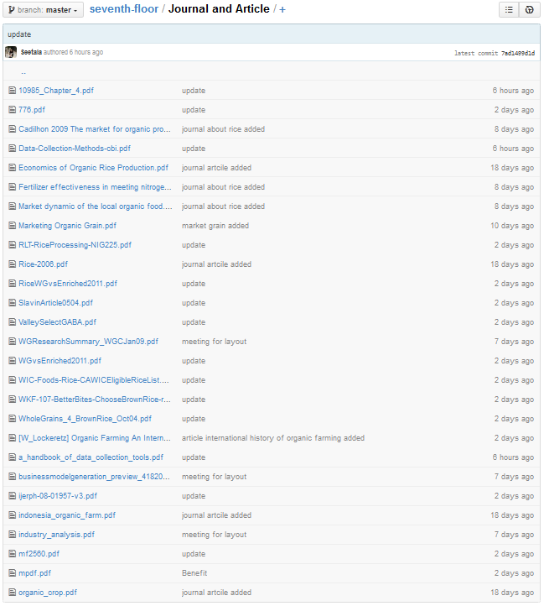
ARTICLE AND JOURNAL
We have collected and learn for 27 articles and journals
Read from website related to organic product and brown rice

Slide 47
GrOUP ACTIVITY
Officially Group Meeting: 8 times
Total time: 34 hours
Meeting time | Topic | Time meeting | Meeting hour
21 March 2015 | Discussion about logic model | 10am - 3 pm | 5
23 March 2015 | Creating ppt for presentation | 1pm-5pm | 4
30 March 2015 | Defining organic food | 10am - 3 pm | 5
4 April 2015 | Collect data and article | 9am-12am | 3
5 April 2015 | Deciding particular organic product | 1pm-5pm | 4
20 April 2015 | Defining outline of the report | 11am-3pm | 4
21 April 2015 | Designing layout | 3pm -5pm and 8pm -11pm | 5
28 April 2015 | Preparing ppt for progress report, revising the outline | 6pm - 10pm | 4

Slide 48
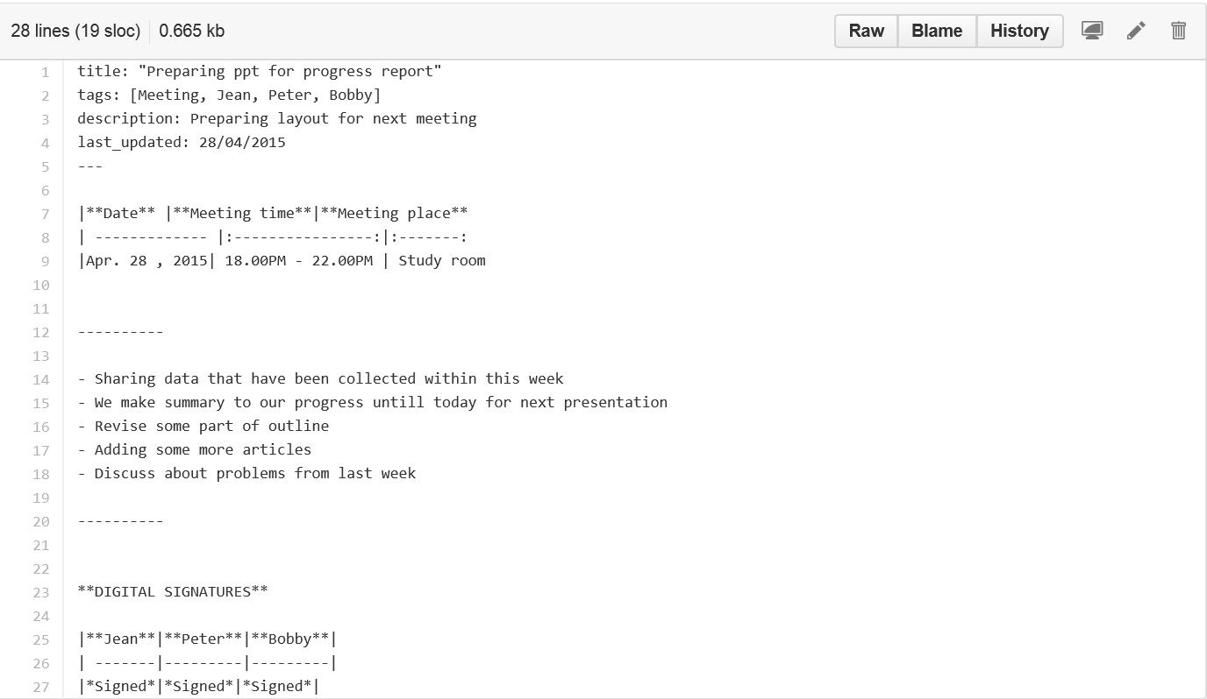
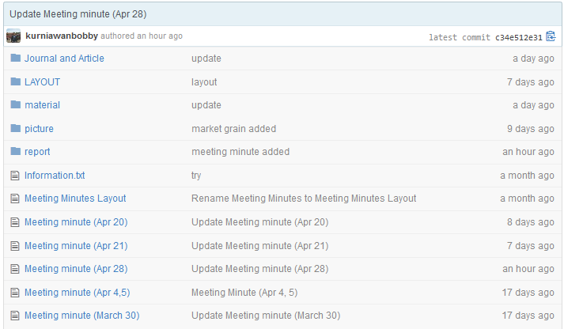
GrOUP ACTIVITY

Slide 49

GrOUP ACTIVITY
Status 28 April 2015 (19:00)

Slide 50
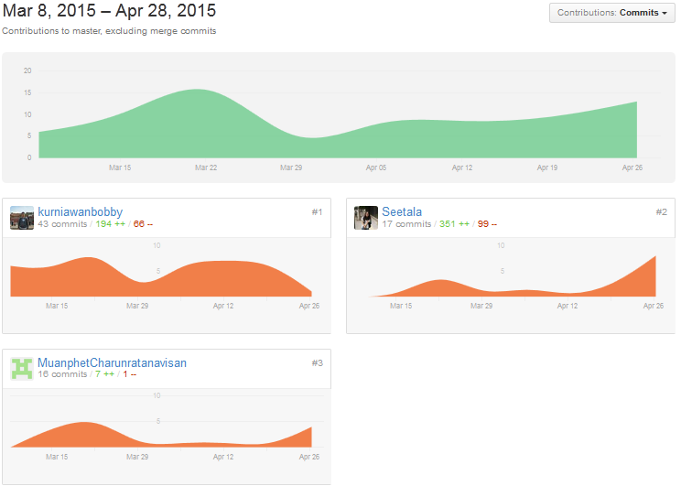
GrOUP ACTIVITY
Status 28 April 2015 (19:00)

Slide 51
7th Floor
Bobby Kurniawan 2014280194
Seetala Ummaralikit 2014280195
Muanphet Charnratanavisan 2014280199

